Slide 1
SI0131 – Dissertation
Week 5
Luke Sloan
Using & Sourcing Secondary Data

Slide 2

Introduction
Defining Data
Advantages of Secondary Data
Disadvantages of Secondary Data
Other Researchers’ Data
National Surveys
Administrative Datasets
Mixing Primary and Secondary
Sources of Secondary Data

Slide 3
Defining Data
Primary Data is…
Collected by you
and/or
Analysed by you first
Secondary Data is…
Collected by others
and/or
Analysed by others first
You design the data collection instrument
Answers your research questions
Lots to think about…
Other researchers’ data
Data collected by institutions in the course of their business
Can be qualitative or quantitative

Slide 4

Advantages of Secondary Data
Useful for small scale research studies…
  Cost and time
  Reanalysis may offer new interpretations
  High quality data (usually…)
  Opportunity of longitudinal data
  Subgroup analysis (decent ‘n’)
  International comparisons
  More time for data analysis

Slide 5

Disadvantages of Secondary Data
Limitations within small scale studies…
  You didn’t ask the questions
  Absence of key variables
  Lack of familiarity with the data
  Inappropriate responses (e.g. age group…)
  Complex coding for missing data
  Weighting and sampling?
  No control over data quality

Slide 6

Other Researchers’ Data
Have they done a good job?
Who are they?
PhD? MSc? UG dissertation? Working paper?
Anyone can put something on the internet…

Slide 7

National Surveys
Well funded and thus well designed
Population or representative (weighted)
Skilled interviewer (reduces bias)
But can be dated (last census available for 2001)
Questions are not always what you want
What level is the data available at (rarely individual due to anonymity issues)

Slide 8
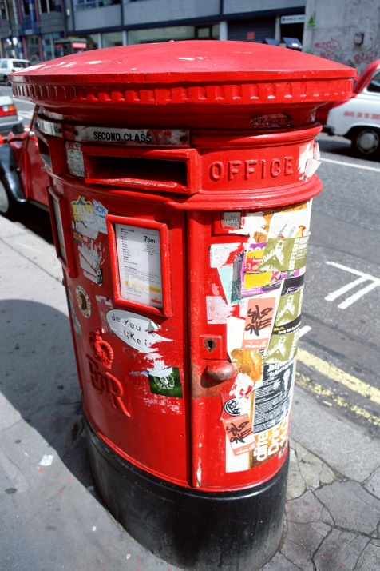
Administrative Datasets
High quality and high fidelity
Rarely useful on their own
Powerful when combined
E.g. local authority boundaries, postcodes, HESA data etc, populations, unemployed, immigration…

Slide 9
Mixing Primary & Secondary
The two are not incompatible
Use secondary data to frame research question
Identify a gap in existing research
Use statistics to justify project (e.g. increase in drug related crime, deprivation, illness)
Primary data can be used to enhance secondary data through the addition of new variables (although unlikely that you can ask the same respondents…)

Slide 10



Sources of Secondary Data I
Survey Question Bank
  http://surveynet.ac.uk/sqb/
  Identify good question and trace source
The Office for National Statistics
  www.statistics.gov.uk
  Neighbourhood statistics, Census data etc…
UK Economic and Social Data Service
  www.esds.ac.uk
  Full of archived datasets
  Including qualitative data: http://www.esds.ac.uk/qualidata/create/introduction.asp

Slide 11



Sources of Secondary Data II
StatsWales
  http://statswales.wales.gov.uk/index.htm
  Administrative data for Wales
Census Dissemination Unit Website
  www.census.ac.uk
  ‘Academic’ equivalent of official data
UK Data Archive
  www.data-archive.ac.uk
  Related to ESDS, but clearer?

Slide 12



Sources of Secondary Data III
Newspapers (LexisNexis?)
Company of organisation reports
Government departments (Defence, Health)
OFSTED/ESTYN reports
Archived Documents
Parliamentary research papers (Hansard?)

Slide 13
Any Questions?

